Slide 1
Unit -1 Introduction to Kubernetes

Slide 2
Prerequisits Link
https://devopscube.com/learn-kubernetes-complete-roadmap/?ref=devopscube.com

Slide 3
Unit-1 Topics
Introduction to Kubernetes :
Containerization,
Tools for Containerization,
Kubernetes Overview,
Kubernetes Concept,
Use of Kubernetes,
Kubernetes Master-Slave Architecture.

Slide 4
Kubernetes Overview
Kubernetes, also known as K8s, is an open source system for automating deployment, scaling, and management of containerized applications.
The open source project is hosted by the Cloud Native Computing Foundation (CNCF).
Kubernetes (K8s) is an open-source container orchestration platform originally developed by Google.
It automates the deployment, scaling, and management of containerized applications across clusters of machines.\

Slide 5
The Problem Kubernetes Solves
Restaurant Chain Analogy:
Without orchestration: You manually call each restaurant to check status, manually send staff when busy, manually coordinate deliveries.
With Kubernetes: Automated system monitors all locations, automatically sends help where needed, coordinates everything centrally.

Slide 6
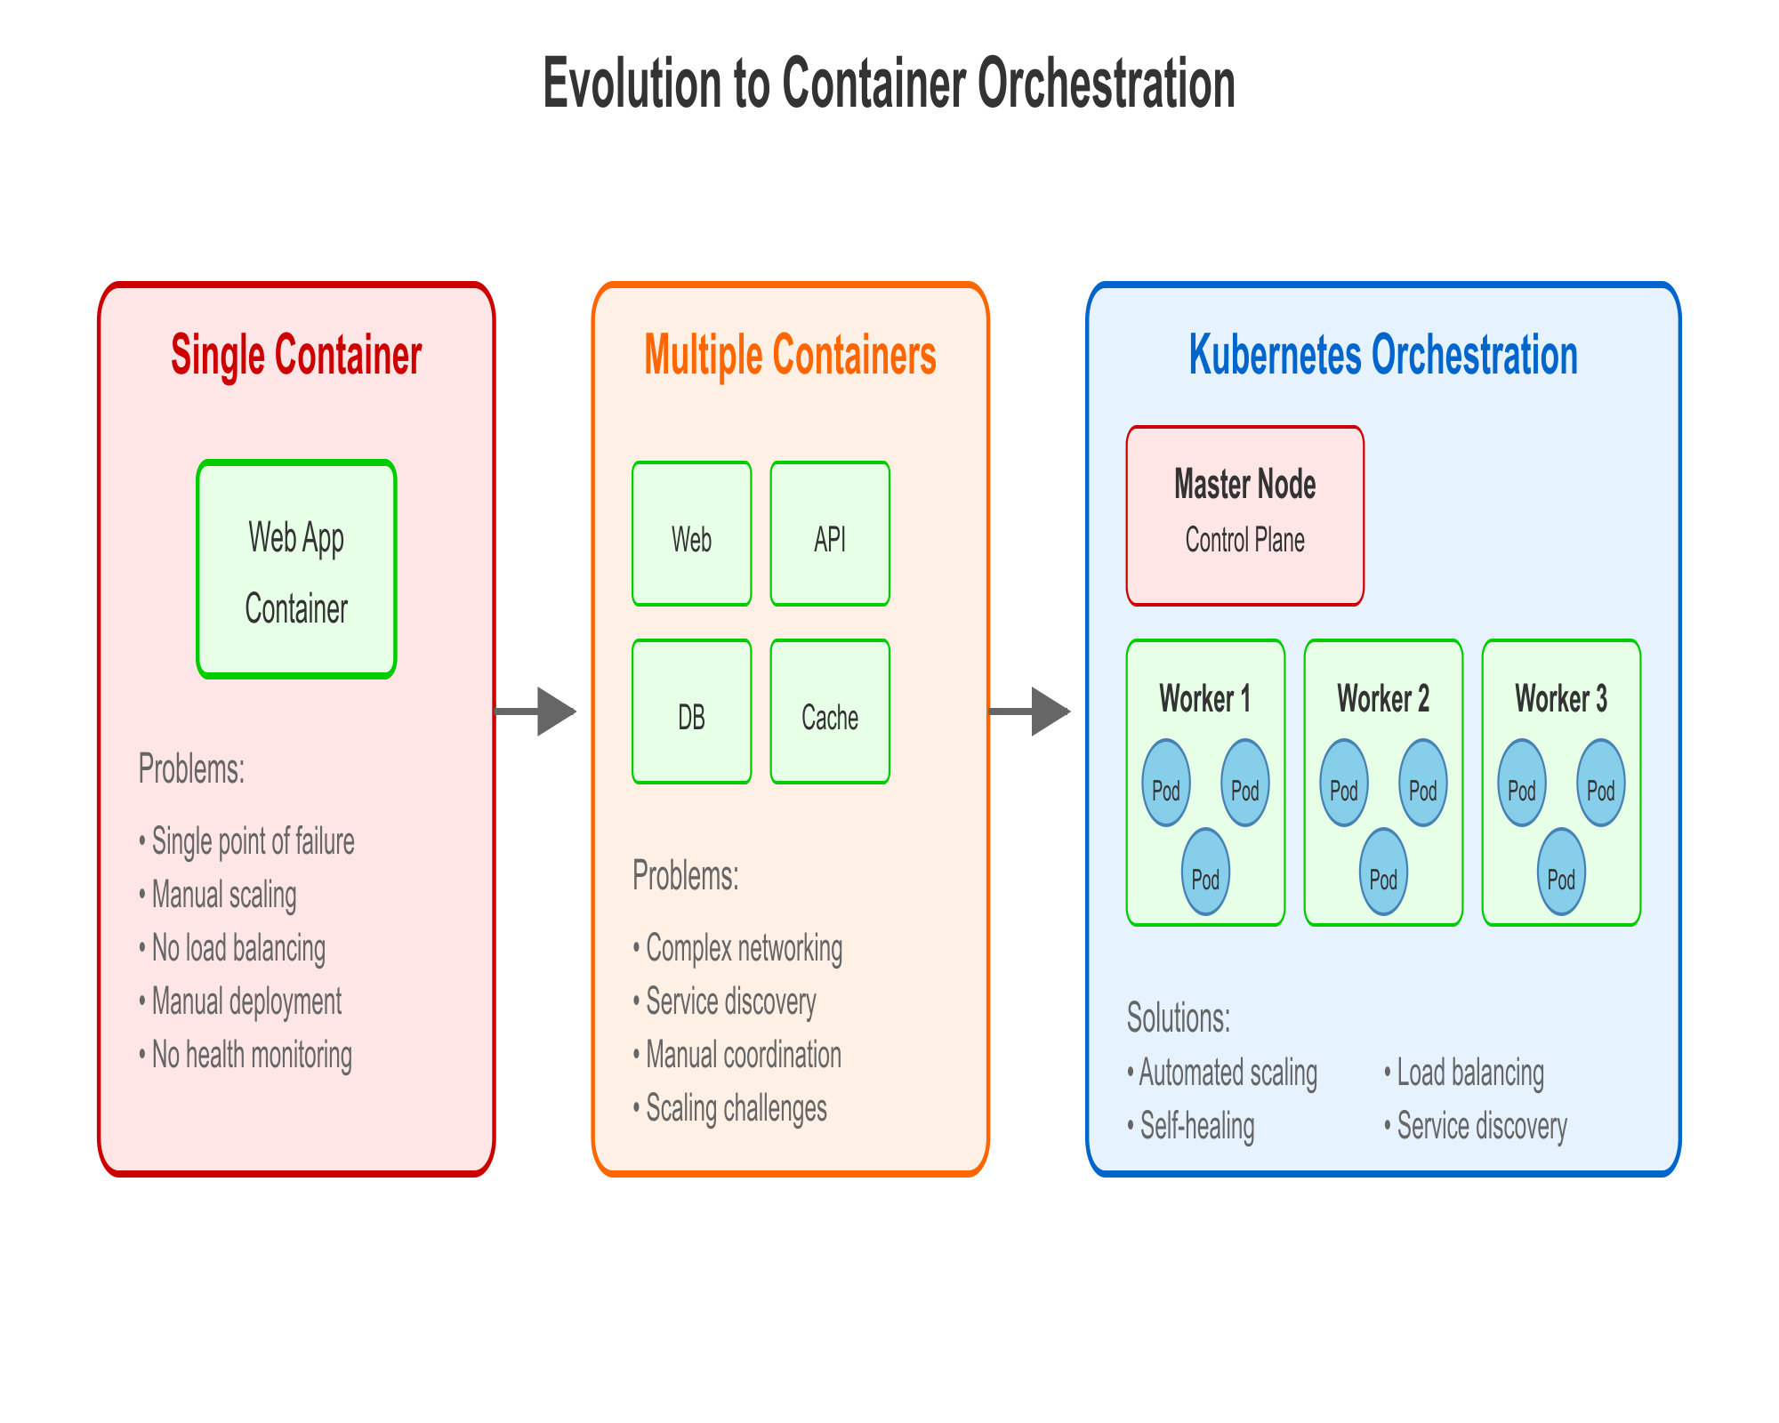
Evolution to Container Orchestration

Slide 7
What Kubernetes Provides
Automated Deployment: Deploy applications with simple commands
Scaling: Automatically scale based on CPU/memory usage or custom metrics
Load Balancing: Distribute traffic across multiple application instances
Self-Healing: Automatically restart failed containers and replace unhealthy nodes
Service Discovery: Applications can find and communicate with each other automatically
Storage Orchestration: Automatically mount storage systems
Secret Management: Securely deploy and manage sensitive information
Rolling Updates: Update applications without downtime
Resource Management: Efficiently allocate CPU and memory across cluster

Slide 8
Real-World Kubernetes Use Cases
Netflix Example:
Scale: Runs thousands of microservices
Auto-scaling: Automatically handles traffic spikes (new movie releases)
Fault tolerance: If one service fails, others continue working
Global reach: Manages content delivery across multiple regions
Deployment frequency: Hundreds of deployments per day
Spotify Example:
Music streaming: Handles millions of concurrent streams
Feature deployment: Rapidly deploy new features to different user segments
Data processing: Manages complex data pipelines for recommendations
Resource optimization: Automatically provisions resources based on usage patterns

